Slide 1






CHAPTER 3. Concurrency, CPU Bound vs I/O Bound
동시성과 병렬성 배우기
What Is Concurrency
고수가 되는 파이썬
좋은사람

Slide 2







CHAPTER 3. Concurrency, CPU Bound vs I/O Bound
오늘 배울 내용
Concurrency(동시성)
Concurrency vs Parallelism

Slide 3
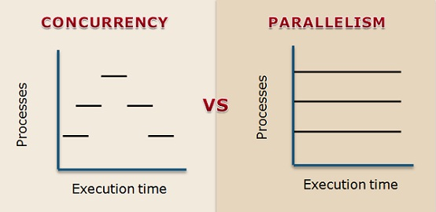
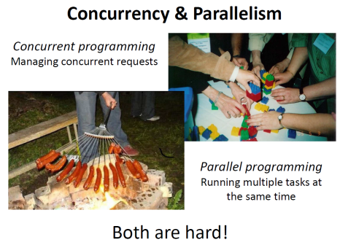
https://gerard.run/posts/python-mp-1/

Slide 4

CHAPTER 3. Concurrency, CPU Bound vs I/O Bound
감사합니다

